Slide 1
K-Means Clustering and Latent Dirichlet Allocation (LDA) using Databricks Spark ML and Microsoft Azure ML Studio:
An Analysis of Stack 0verflow for R Language Question and Answers

Slide 2
The Scenario
What is Stack Overflow?
Stack Overflow is a question and answer site for professional and enthusiast programmers. It's built and run by you as part of the Stack Exchange network of Q&A sites.
What is our idea?
Our idea is to train, test, and evaluate ML models to predict
“if an answer submission is acceptable to the question”
What are our Machine Learning Algorithms?
K-Means Clustering
Latent Dirichlet Allocation (LDA)

Slide 3
Data Source and Data Size
R language questions from Stack Overflow
R language answers from Stack Overflow
Question and answer tags
https://www.kaggle.com/stackoverflow/rquestions
Data size: 2GB

Slide 4
H/W Experimental Specifications
Databricks Community
Execution: Single Node
Max Storage 6 GB Memory
Databricks Runtime Version 4.0
Includes Apache Spark 2.3.0, Scala 2.11
Microsoft Azure ML Studio
Execution: Single Node
Max storage space: 10 GB Memory
Compute Resource Type:
The Machine Learning service is a multitenant service

Slide 5
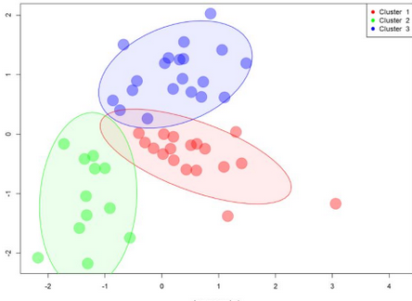
K-Means Clustering
K-means clustering is a type of unsupervised learning, which is used when you have unlabeled data.
The goal of this algorithm is to find groups in the data, with the number of groups represented by the variable K.
Data points are clustered based on feature similarity.

Slide 6
K-Means Clustering on Databricks
Two centroids were used in to build the model by setting knum=2, equal to two cluster centers
StringIndexer was used to index the feature, IsAccepted before transformation was called
ClusteringEvaluator was imported to evaluate
Cluster Center:
3.46914131e+06 | 3.70142698e+07 | 1.59308163e+00 | 4.67536876e-01
1.49612531e+06 | 1.62056550e+07 | 4.69450501e+00 | 4.14542898e-01

Slide 7
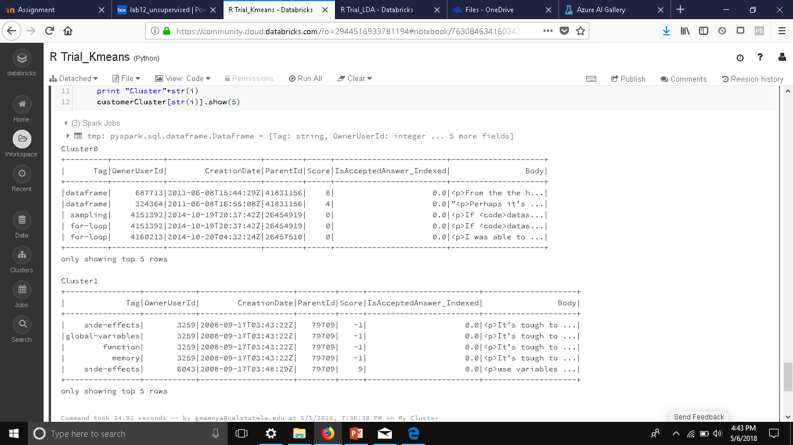
Clustering Results Based for K-Means Clustering on Databricks
This table shows the each the features and values of the similar points each of the two clusters

Slide 8
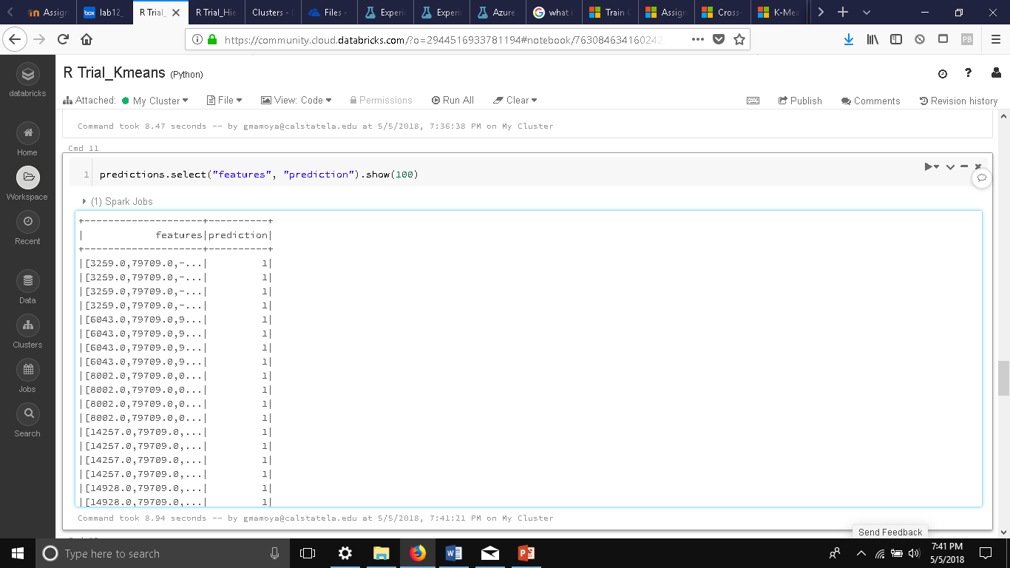
Prediction Results Based for K-Means Clustering on Databricks
The prediction model clustered non-unique features like Month, Day, Year, Tag, OwnerUserID, and Score
The following results uses these key features to model “if the answer is acceptable” based on actual and predicted.
Squared Euclidean Distance= 0.7681

Slide 9
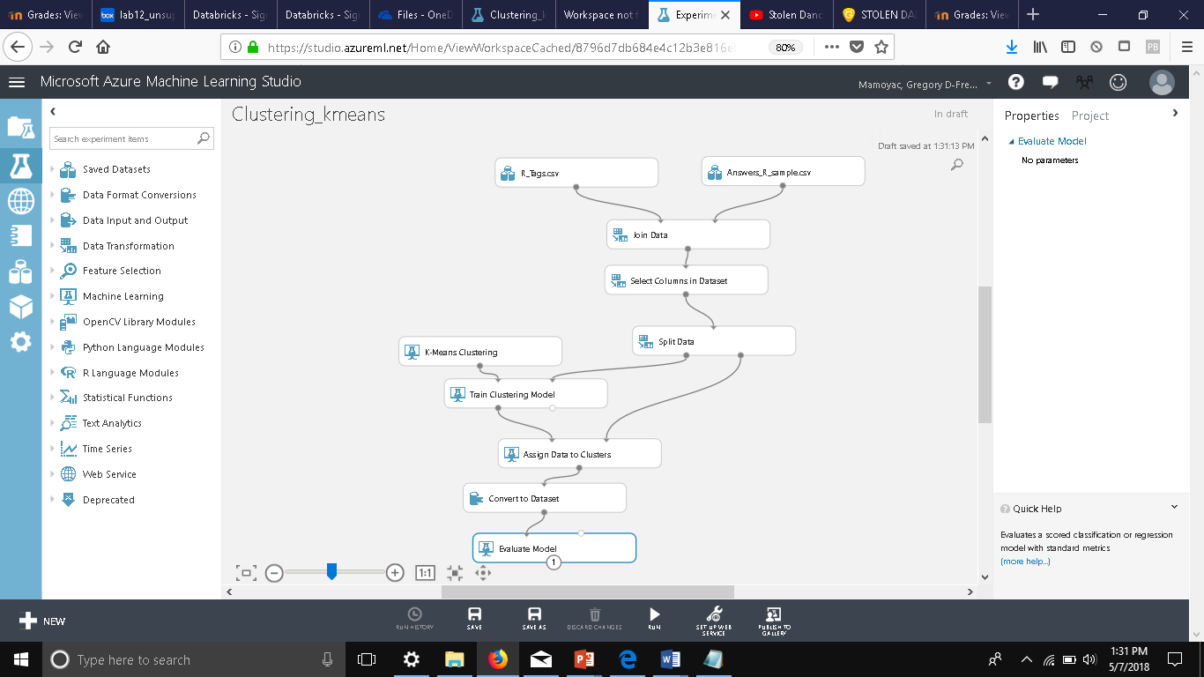
K-Means Clustering on Azure ML
Columns used: Id Tag OwnerUserId ParentId Score IsAcceptedAnswer Body Month Day Year
Algorithm: K Means Clustering
Single Parameter
Three Centroids
Euclidean Metric
Iterations: 100
Initialization: Kmeans++Fast

Slide 10
K-Means Clustering on Azure ML
Three centroid were used in K-Means Clustering Module to build the model.
Each of the cluster centers provided metric for distance from the center.
The next graph was visualized on PCA1 and PCA 2 Axis
Principal Component 1 axis is the combined set of features that captures the most variance in the model
Principal Component 2 axis represents some combined set of features that is orthogonal to the first component and that adds the next most information to the chart.

Slide 11
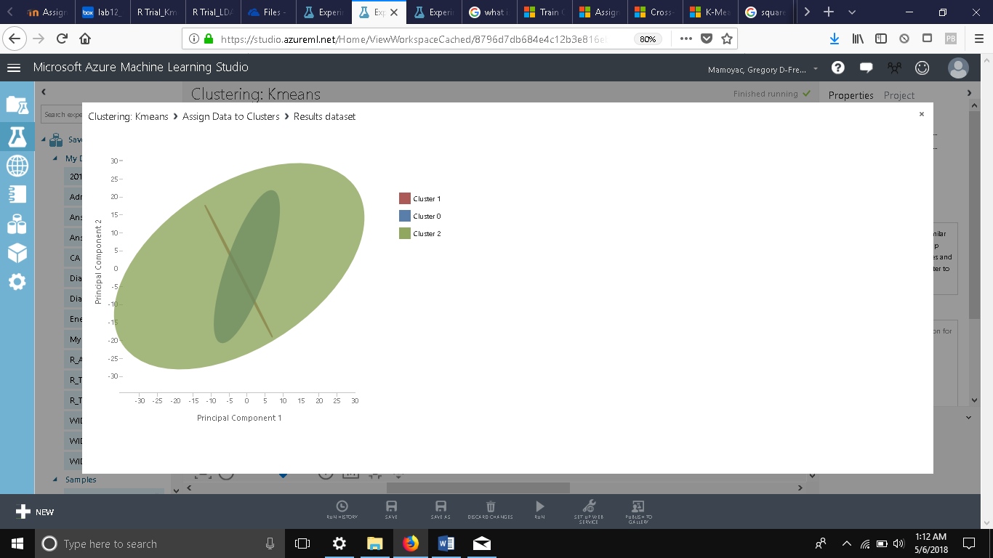
Separation of Clusters for K-Means Clustering on Azure ML
Average Distance from Cluster Center
Cluster 0 (Blue) = 2.39367
Cluster 1 (Red) = 0.97166
Cluster 2 (Green) = 1.41954
The Squared Euclidean Distance =1.028835
The lower the value, the closer the prediction is to the actual value

Slide 12
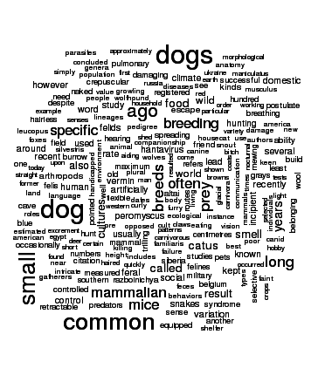
Latent Dirichlet Allocation (LDA)
Latent Dirichlet Allocation (LDA) is an unsupervised learning model.
As a part of natural language, it is a generative statistical model that uses clustering.
It allows sets of observations to be explained by unobserved groups that explain why some parts of the data are similar.
These observations will help us predict “if an answer submission is acceptable to the question”

Slide 13
Latent Dirichlet Allocation (LDA) on Databricks
The data is being broken into 25 centroids called topics (k=25).
Tag: approximation
IsAcceptedAnswer: FALSE
The model is breaking the content of body columns in 25 topics.

Slide 14
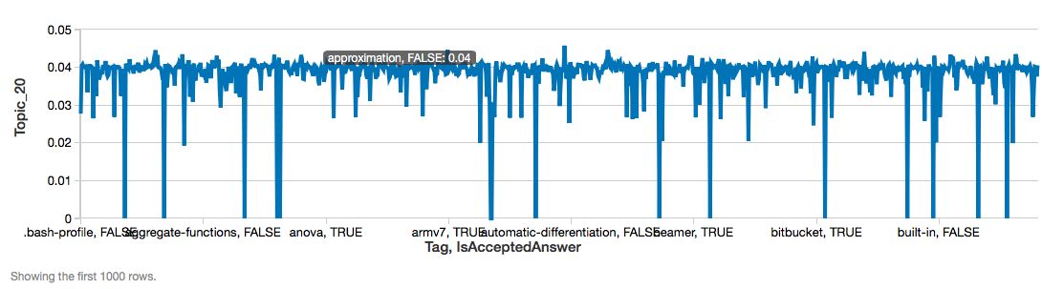
Latent Dirichlet Allocation (LDA) on Databricks
The closer the percentage error of zero the closer the predicted topic is to the actual topic value after clustering 25 topics
The figure shows body columns with a Mean Error Percentage = 4.0%.

Slide 15
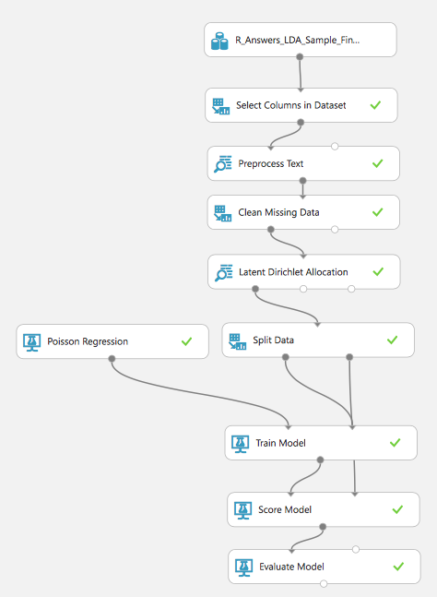
Latent Dirichlet Allocation (LDA) on Azure ML
Model: Latent Dirichlet Allocation (LDA)
HTLM tags were removed using Python script
Missing values were processed with ”Clean Missing Text”
module
Total number of topics: 5
Split was done is 50-50

Slide 16
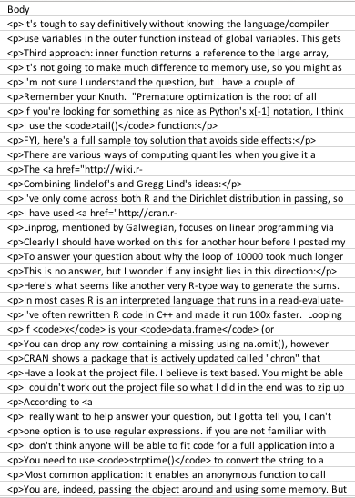
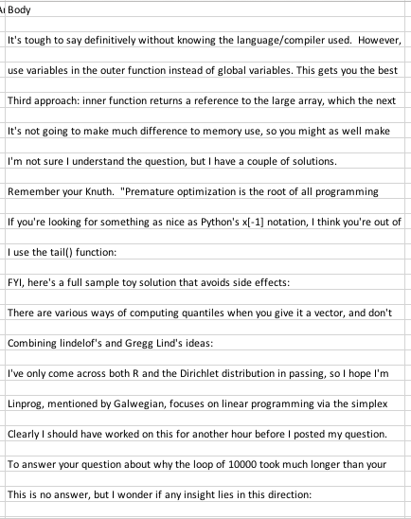
Python Scripting for removing HTML tags

Slide 17
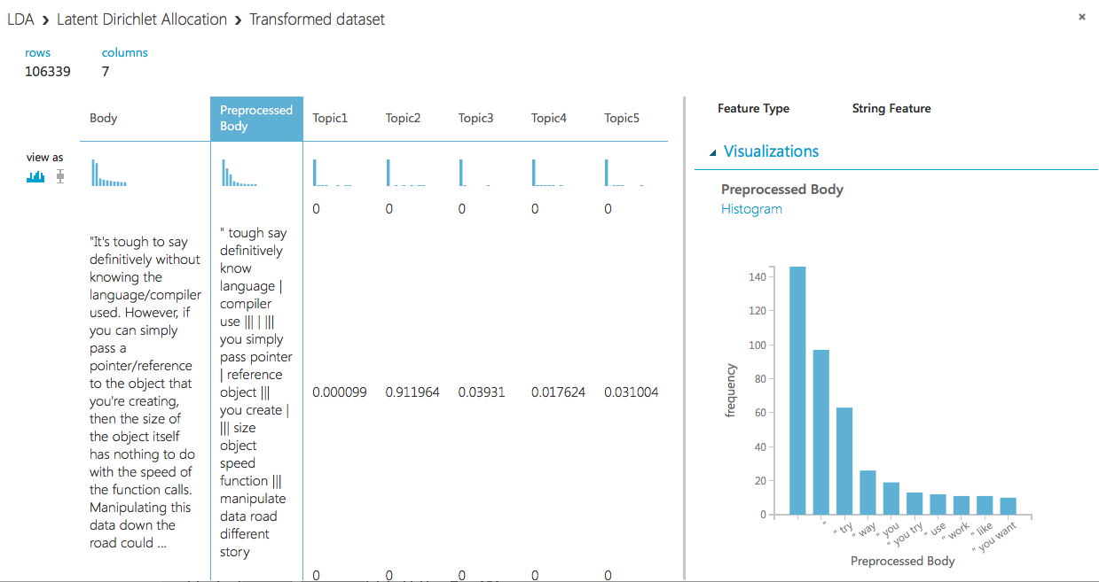
Evaluation for Latent Dirichlet Allocation (LDA) on Azure ML
Latent Dirichlet Allocation (LDA) was achieve by clustering 5 topics from the Body features through the LDA Module and Poisson Regression
The Body was preprocessed for use in NLP functions

Slide 18
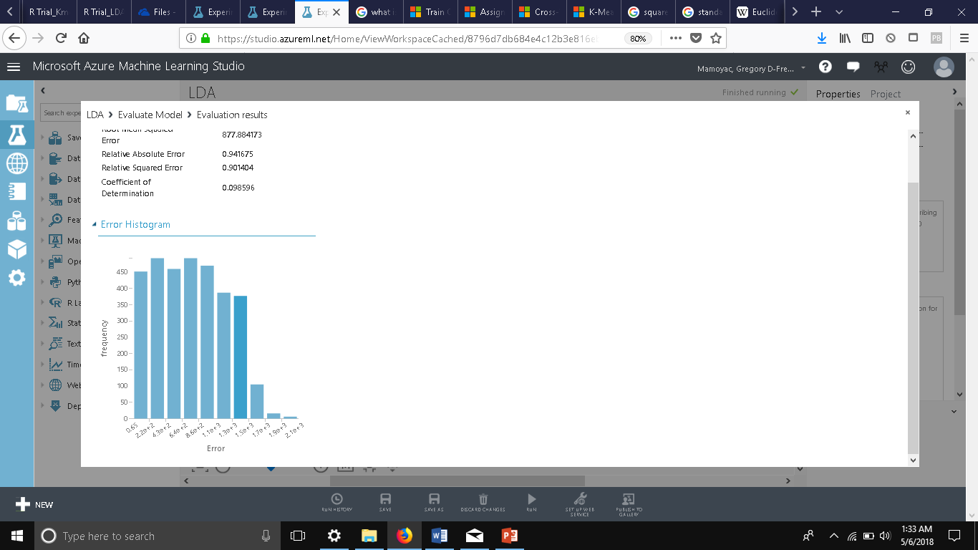
Error Histogram for Latent Dirichlet Allocation (LDA) on Azure ML
This error histogram plots compute the error values as the difference between target values and predicted values into 5 Topics/Centroids
The higher the frequency the closer to zero error occurs
Mean Error Percentage= 3.18%

Slide 19
Conclusion: Results Initial
Microsoft Azure ML
Kmeans
The Squared Euclidean Distance =1.028835
Centroids=3
Latent Dirichlet Allocation (LDA)
Mean Error Percentage= 3.18%
Topic Clusters=5
DataBricks
K-Means
Squared Euclidean Distance= 0.7681
Centroids=2
Latent Dirichlet Allocation (LDA)
Mean Error Percentage = 4.0%
Topic Clusters=25

Slide 20
Conclusion: Results Final – See Term Paper
Microsoft Azure ML
Kmeans
The Squared Euclidean Distance =1.028835
Centroids=3
Latent Dirichlet Allocation (LDA)
Mean Error Percentage= 3.18%
Topic Clusters=5
DataBricks
K-Means
Squared Euclidean Distance= 0.7247
Centroids=3
Latent Dirichlet Allocation (LDA)
Mean Error Percentage =
Topic Clusters=5

Slide 21
References
Martens, J. (n.d.). Azure Machine Learning Studio Algorithm and Module Reference. Retrieved April/May, 2018, from https://docs.microsoft.com/en-us/azure/machine-learning/studio-module-reference
Github
https://github.com/gregmamoyac/CIS5560-Project

Slide 22
Question and Answer Portion…

